Slide 1




Astronomy 1010 chapter 1
Clayton State University
Slides for Astronomy textbook from OpenStax
https://openstax.org/books/astronomy/

Slide 2
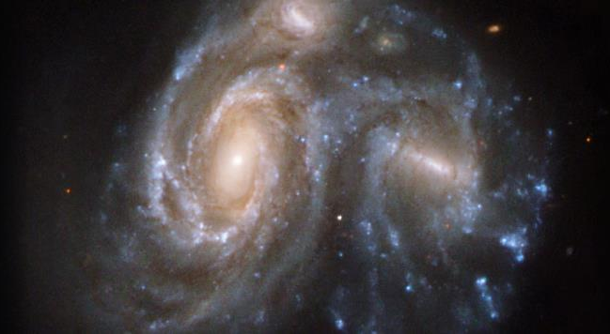
What is Astronomy?
Distant Galaxies. These two interacting islands of stars (galaxies) are so far away that their light takes hundreds of millions of years to reach us on Earth (photographed with the Hubble Space Telescope). (credit: modification of work by NASA, ESA, the Hubble Heritage (STScl/AURA)-ESA/Hubble Collaboration, and K. Noll (STScl))
It is the oldest science in the world
Astronomy is defined as the study of the objects that lie beyond our planet Earth and the processes by which these objects interact with one another.
It is also humanity’s attempt to organize what we learn into a clear history of the universe, from the instant of its birth in the Big Bang to the present moment.

Slide 3

What is science?
Science is…
  Around the circle:
What do you think science is?
What do scientists do?
How is it different from philosophy and believes?

Slide 4
Scientific method explained
The ultimate judge in science is always what nature itself reveals based on observations, experiments, models, and testing.
Science is not merely a body of knowledge, but a method by which we attempt to understand nature and how it behaves. This method begins with many observations over a period of time.
From the trends found through observations/experiments, scientists can model the particular phenomena we want to understand. Such models are always approximations of nature, subject to further testing.
When they are first proposed, new models or ideas are sometimes called hypotheses.

Slide 5
Scientific method explained 2
A hypothesis must be a proposed explanation that can be tested. That is, it must both explain the existing data and make predictions as well!
  The most straightforward approach to such testing in science is to perform an experiment. If the experiment is conducted properly, its results either will agree with the predictions of the hypothesis or they will contradict it.
  If the experimental result is truly inconsistent with the hypothesis, a scientist must discard the hypothesis and try to develop an alternative.
  If the experimental result agrees with predictions, this does not necessarily prove that the hypothesis is correct; perhaps later experiments will contradict crucial parts of the hypothesis.
  But the more experiments that agree with the hypothesis, the more likely we are to accept the hypothesis as a useful description of nature.
Experiments can be done by anyone and anywhere given the proper procedure!

Slide 6
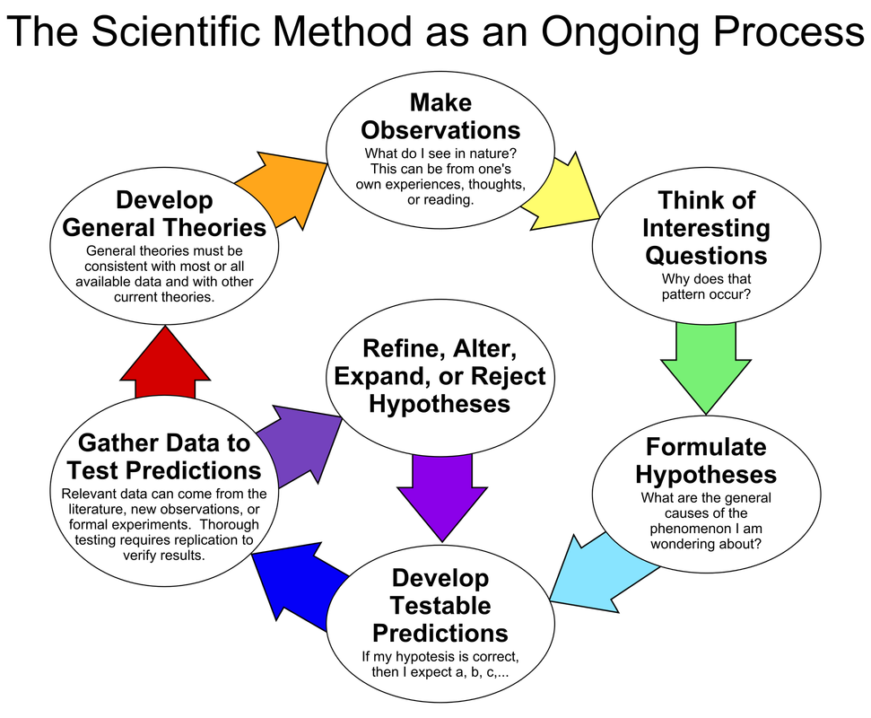
Scientific method explained 3

Slide 7
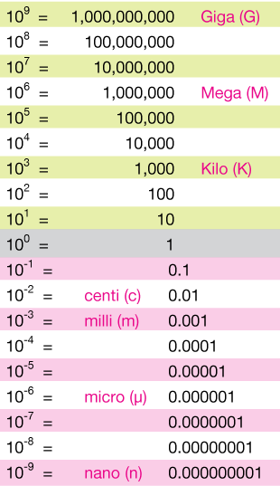
Scientific notation refresher
Astronomy uses very large numbers
Scientific notation is most useful to right them down
2.5 x 10¹² means to take 2.5, move the decimal 12 places to the right and fill in the open gaps with zeros to make 2,500,000,000,000 or 2.5 trillion. In scientific notation, the number on the left is always a single digit followed by a decimal point and the correct (see significant figures) number of digits after the decimal.
-3.2 x 10⁻⁵ means to take the negative number -3.2, and move the decimal 5 places to the left, filling in the open gaps with zeros to make -0.000032. Notice that the minus sign to the left of the 3.2 has nothing to do with the exponent, and simply indicates a negative number.
Mass of the Sun is 2 10³⁰ kg (note that x is typically omitted)

Slide 8
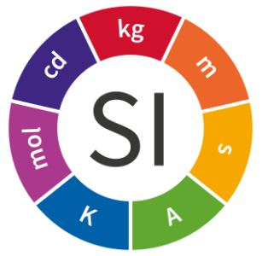
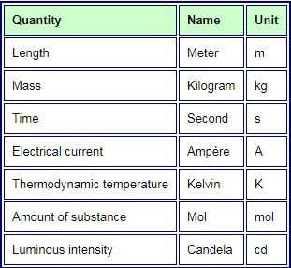
SI units, CGS units
1 m³ of water weighs about 1 ton or 1000 kg. 1000 cm³ of water is 1 liter or 1 kg.
Astronomy often uses CGS system: centimeter, gram, second.
  Derived units will change accordingly
  In this class, only SI
Three temperature scales are in general use:
  Fahrenheit (F); water freezes at 32 °F and boils at 212 °F.
  Celsius (C); water freezes at 0 °C and boils at 100 °C.
  Kelvin (or absolute) (K); water freezes at 273 K and boils at 373 K.
All molecular motion ceases at about −459 °F = −273 °C = 0 K, a temperature called absolute zero.
The full conversion formulas are:
K = °C + 273
°C = (5/9) × (°F – 32)
°F = (9/5) × °C + 32
Notes:
Talk about

Slide 9
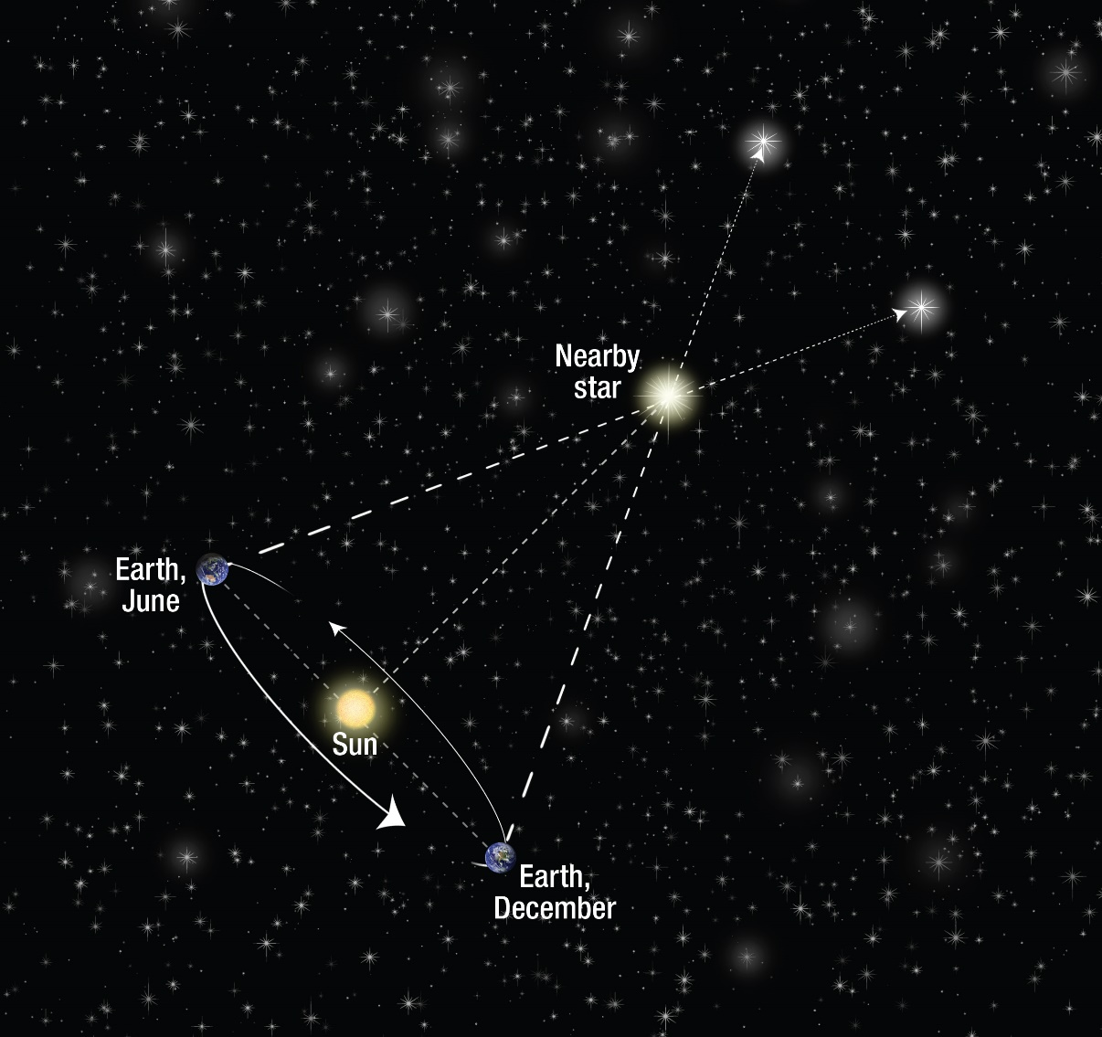
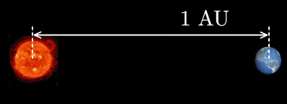
Scale of Astronomy
Parallax definition of stellar distances
Astronomical Constants
astronomical unit (AU) 1.496 × 10¹¹ m
Light-year (ly) 9.461 × 10¹⁵ m
parsec (pc) 3.086 × 10¹⁶ m = 3.262 light-years
sidereal year (y) 3.156 × 10⁷ s
mass of Earth (MEarth) 5.974 × 10²⁴ kg
equatorial radius of Earth (REarth) 6.378 × 10⁶ m
1 arc second
1 parsec
1 AU
https://hubblesite.org/image/3148/category/12-cosmology
https://sites.google.com/site/chemphyschanges/astronomical-unit

Slide 10
Getting Familiar with a Light-Year
How many kilometers are there in a light-year?
Solution
Light travels 3 × 10⁵ km in 1 s. So, let’s calculate how far it goes in a year: There are 60s in 1 min, and 60 min in 1 h.
Multiply these together and you find that there are 3.6 × 10³ s/h.
Thus, light covers 3 × 10⁵ km/s × 3.6 × 10³ s/h = 1.08 × 10⁹ km/h.
There are 24 h in a day, and 365.25 (3.65 × 10²) days in 1 y.
The product of these two numbers is 8.77 × 10³ h/y.
Multiplying this by 1.08 × 10⁹ km/h gives 9.46 × 10¹² km/light-year.
That’s almost 10,000,000,000,000 km that light covers in a year. To help you imagine how long this distance is, we’ll mention that a string 1 light-year long could fit around the circumference of Earth 236 million times.

